Slide 1
EPrints / EPrints Services
Update

Slide 2
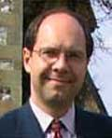
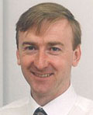
EPrints Services
Academic
Director
Les Carr
Management
Justin Bradley
Kelly Terrell
Adam Field
Sheridan Brown
John Darlington
Jiadi Yao
Will Fyson
Dave Newman
Huw Fryer
Sales &
Marketing
Repository Developers

Slide 3
EPrints Services
Not for profit
Exists to serve the OA community
Commercial Services (hosting, support, etc)
Lead on EPrints roadmap and releases
Provides funding for EPrints development & community activities

Slide 4
EPrints Software
Our Vision

Slide 5
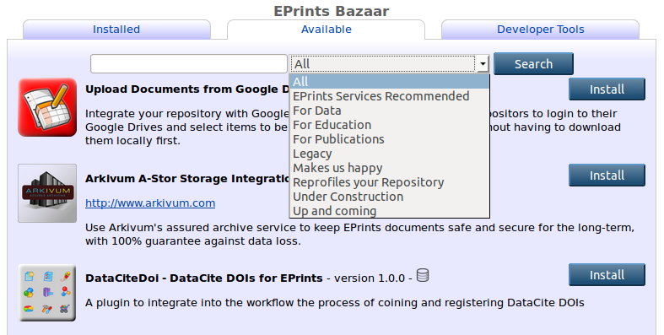
EPrints 3.3.14

Slide 6
EPrints 4 / 3.4.0 Key Philosophy
“Base” EPrints storing and handling of generic data and objects
“Layers” to handle specific metadata schema, import/export, rendering, search, etc. for specific domains

Slide 7
3.4 Releases
Collections of metadata schemas, renderers, plugins and packages tested together for a specific purpose (the pizza model)
Initial Releases for:
Open Access Publications
Open Education
Open Research Data

Slide 8
EPrints 3.4 for Publications
Publications
Metadata Schema
IRUS Tracker
Publications Router
ORCID Support
WOK / Scopus
Projects / Funder & Rioxx2
IRStats 2
Base

Slide 9
EPrints 3.4 for Open Education
Education
Metadata Schema
MePrints
Bookmarks
Collections
EdShare Style User Interface
Base

Slide 10
EPrints 3.4 for Open Research Data
Research Data
Metadata Schema
ReCollect
DataCite
Arkivum
Exemplar Simple
Storage Plugin
Large File Upload Mechanisms
Base

Slide 11
EPrints for Dataset Showcases
Bespoke Dataset
Importer
Renderer
Base

Slide 12
EPrints for Social Media Data
Research Data
Metadata Schema
Bespoke Dataset
Big Data Management
Importer
Renderer
Exporters
Base

Slide 13
Community Activities

Slide 14
Community Engagement
New Role in EPrints Services
To understand and promote community agendas
To support community members
To facilitate community contributions
Collaborating with other stakeholders
Recent Activities
Supported development *
Training videos *
Wiki Improvements *
EP-tech interaction
Nagging for documentation
* Questions Encouraged (I could talk for hours)

Slide 15
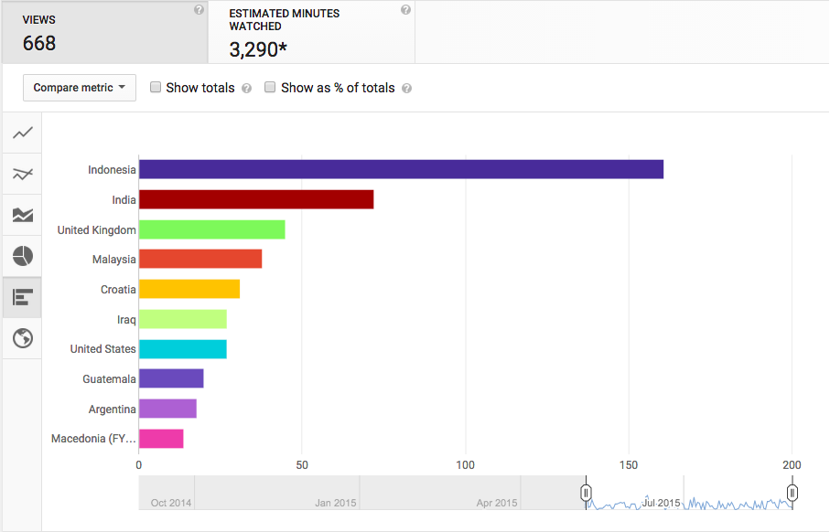
A Global Community!

Slide 16
Next Up
EPrints UK User group meeting
September 11th, Southampton

